Slide 1
LibreOffice Python Part 1
Setting up LibreOffice to provide Python scripting.
Hamilton Python User Group Presentation
2015 April 13
Ian Stewart
V1.0
https://github.com/hampug

Slide 2
Check python3 is available...
>>>
~/==> python3
Python 3.4.0 (default, Apr 11 2014, 13:05:11)
[GCC 4.8.2] on linux
Type "help", "copyright", "credits" or "license" for more information.
>>>

Slide 3
Check if python3-uno is available...
If no python3-uno then install it...
~/==> python3
Python 3.4.0 (default, Apr 11 2014, 13:05:11)
[GCC 4.8.2] on linux
Type "help", "copyright", "credits" or "license" for more information.
>>> import uno
>>> dir(uno)
['Any', 'Bool', 'ByteSequence', 'Char', 'Enum', 'Type', '__builtin__', '__builtins__', '__cached__', '__doc__', '__file__', '__loader__', '__name__', '__package__', '__spec__', '_g_ctx', '_g_delegatee', '_impl_extractName', '_uno_extract_printable_stacktrace', '_uno_import', '_uno_struct__eq__', '_uno_struct__getattr__', '_uno_struct__init__', '_uno_struct__repr__', '_uno_struct__setattr__', '_uno_struct__str__', 'absolutize', 'createUnoStruct', 'fileUrlToSystemPath', 'generateUuid', 'getClass', 'getComponentContext', 'getConstantByName', 'getCurrentContext', 'getTypeByName', 'invoke', 'isInterface', 'os', 'pyuno', 'setCurrentContext', 'socket', 'sys', 'systemPathToFileUrl', 'unicode']
>>>
~/==> sudo apt-get install python3-uno

Slide 4
What is python3-uno?
https://packages.debian.org/sid/python3-uno
The Python-UNO bridge allows use of the standard LibreOffice API with the Python scripting language. It additionally allows others to develop UNO components in Python, thus Python UNO components may be run within the LibreOffice process and can be called from C++ or the built in StarBasic scripting language.
Also see...
http://api.libreoffice.org/examples/DevelopersGuide/examples.html
https://wiki.openoffice.org/wiki/Python_as_a_macro_language

Slide 5
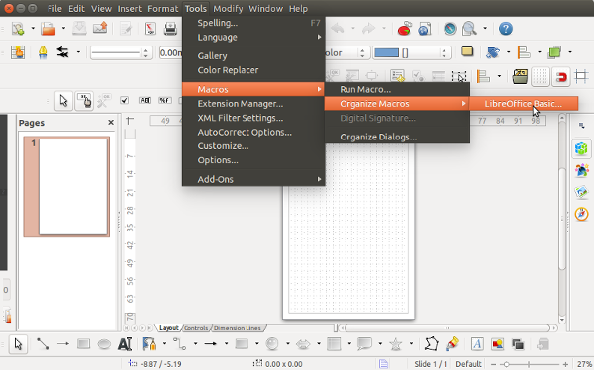
Is Python macro scripting available? Maybe there is only the integrated Basic marco scripting?

Slide 6
Installing the LibreOffice script provider for python
Note: /usr/lib/libreoffice/program/pythonscript.py
GLOBAL_SCRIPTCONTEXT_NAME = "XSCRIPTCONTEXT"
~/==> sudo apt-get install libreoffice-script-provider-python
Reading package lists... Done
Building dependency tree
Reading state information... Done
The following packages were automatically installed and are no longer required:
python3-mccabe python3-pep8
Use 'apt-get autoremove' to remove them.
The following NEW packages will be installed:
libreoffice-script-provider-python
0 upgraded, 1 newly installed, 0 to remove and 361 not upgraded.
Need to get 30.1 kB of archives.
After this operation, 218 kB of additional disk space will be used.
Get:1 http://nz.archive.ubuntu.com/ubuntu/ trusty-updates/universe libreoffice-script-provider-python all 1:4.2.7-0ubuntu2 [30.1 kB]
Fetched 30.1 kB in 0s (132 kB/s)
Selecting previously unselected package libreoffice-script-provider-python.
(Reading database ... 378604 files and directories currently installed.)
Preparing to unpack .../libreoffice-script-provider-python_1%3a4.2.7-0ubuntu2_all.deb ...
Unpacking libreoffice-script-provider-python (1:4.2.7-0ubuntu2) ...
Setting up libreoffice-script-provider-python (1:4.2.7-0ubuntu2) ...
~/==>

Slide 7
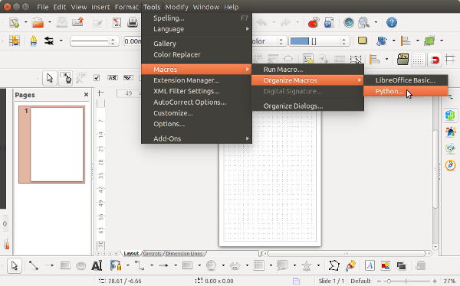
Python macro scripting is now available...
...so lets see if there is any example python programs.

Slide 8
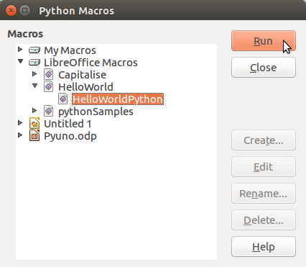
The LibreOffice Python “Shared Marco's Library” contains three sample python programs.
Run the HellowWorldPython() python function that is in the file “HelloWorld.py”
Note that Create, Edit, Rename and Delete are not available for python. They can only be used with the Basic IDE.

Slide 9
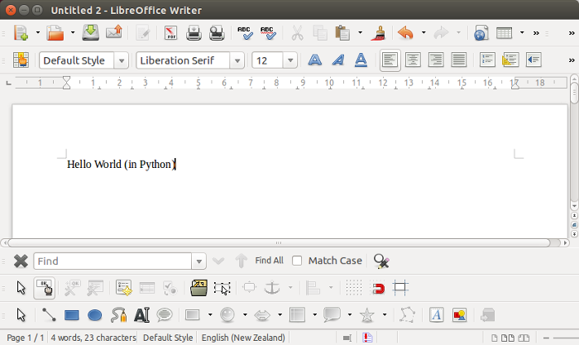
The HellowWorldPython() python function that is in the file “HelloWorld.py” created a new Write document and inserted some text...

Slide 10
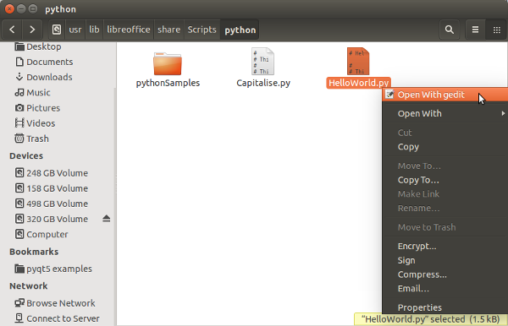
Review of the example python program files in the Shared library...
Shared library path: usr/lib/libreoffice/share/Scripts/python

Slide 11
HelloWorld.py with the function “HelloWorldPython():”...
# HelloWorld python script for the scripting framework
#
# This file is part of the LibreOffice project.
def HelloWorldPython( ):
"""Prints the string 'Hello World(in Python)' into the current document"""
#get the doc from the scripting context which is made available to all scripts
desktop = XSCRIPTCONTEXT.getDesktop()
model = desktop.getCurrentComponent()
#check whether there's already an opened document. Otherwise, create a new one
if not hasattr(model, "Text"):
model = desktop.loadComponentFromURL(
"private:factory/swriter","_blank", 0, () )
#get the XText interface
text = model.Text
#create an XTextRange at the end of the document
tRange = text.End
#and set the string
tRange.String = "Hello World (in Python)"
return None

Slide 12
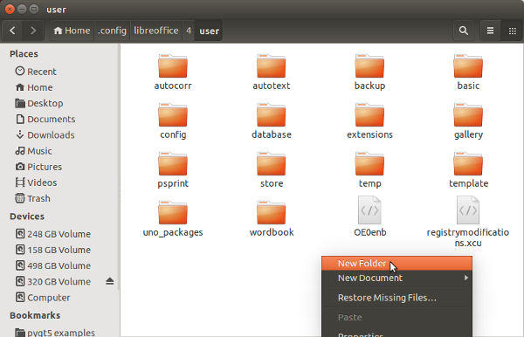
Create the User library for python. Create a “Scripts” folder in ~/.config/libreoffice/4/user/...
User library is best for developing a python program. Can move the program to another library later.
User library for Basic exists by default.

Slide 13
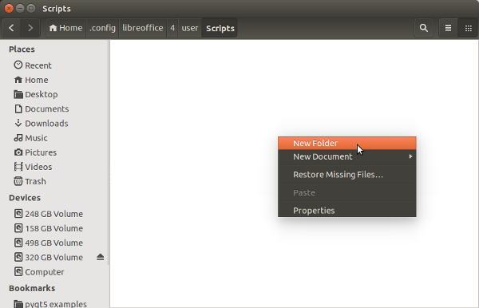
Create the “python” folder in “Scripts” folder...

Slide 14
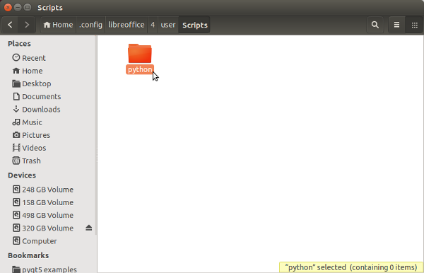
Go into the python folder...

Slide 15
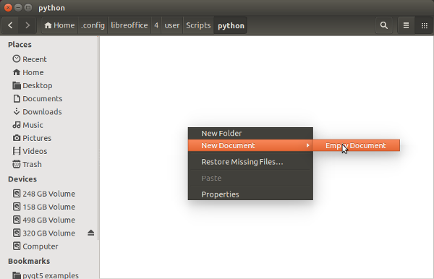
Create a helloworld.py file in the python folder

Slide 16
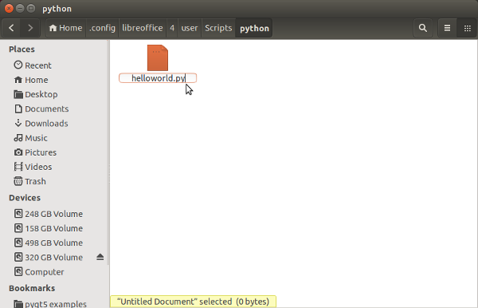
Edit the empty helloworld.py file...
Path to python file:
~/.config/libreoffice/4/user/Scripts/python/helloworld.py

Slide 17
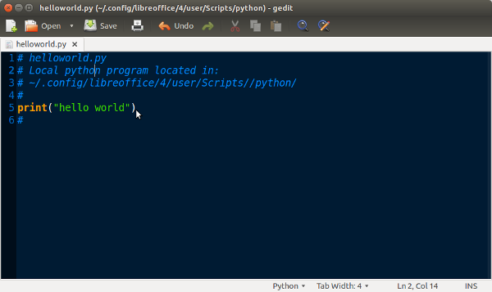
Write a python program...

Slide 18
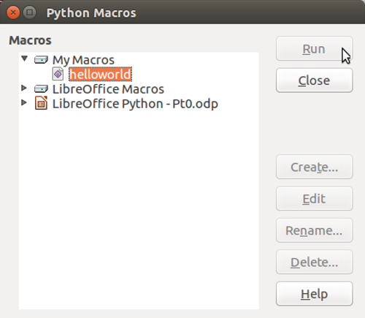
Helloworld.py is now displayed in the User library “My Macros”...
...but, because helloworld has no functions() it won't run...

Slide 19
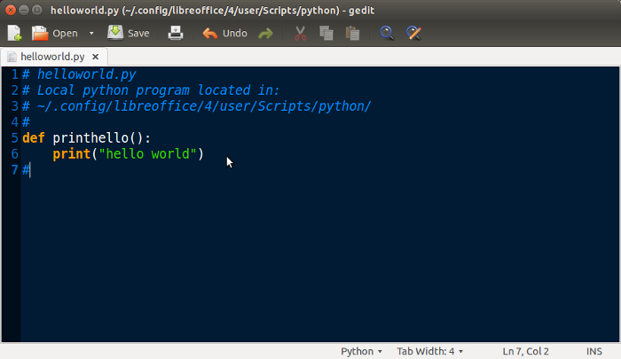
Edit python program to create the function printhelllo(): ...

Slide 20
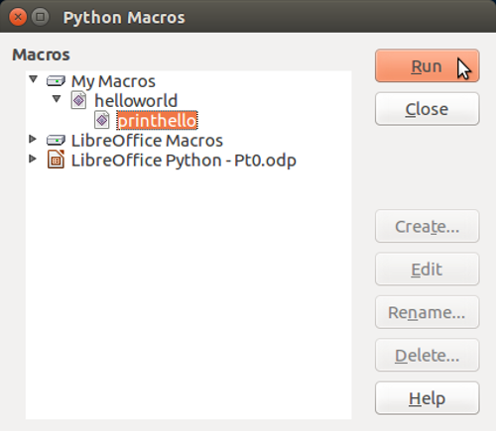
Helloworld.py is now displayed in the User library “My Macros” with the function printhello() hightlighted and it can be Run...
...it Runs, but there is no stdout, so you don't see any “hello world”...

Slide 21
End of Part 1
Goto Part 2 to write a python program in the User macro library that will run and that has visible output.

Slide 22
PS: An observation... Python2 doesn't import uno but python3 does...
~/==> python
Python 2.7.6 (default, Mar 22 2014, 22:59:56)
[GCC 4.8.2] on linux2
Type "help", "copyright", "credits" or "license" for more information.
>>> import uno
Traceback (most recent call last):
File "<stdin>", line 1, in <module>
ImportError: No module named uno
>>>
~/==> python3
Python 3.4.0 (default, Apr 11 2014, 13:05:11)
[GCC 4.8.2] on linux
Type "help", "copyright", "credits" or "license" for more information.
>>> import uno
>>> dir(uno)
['Any', 'Bool', 'ByteSequence', 'Char', 'Enum', 'Type', '__builtin__', '__builtins__', '__cached__', '__doc__', '__file__', '__loader__', '__name__', '__package__', '__spec__', '_g_ctx', '_g_delegatee', '_impl_extractName', '_uno_extract_printable_stacktrace', '_uno_import', '_uno_struct__eq__', '_uno_struct__getattr__', '_uno_struct__init__', '_uno_struct__repr__', '_uno_struct__setattr__', '_uno_struct__str__', 'absolutize', 'createUnoStruct', 'fileUrlToSystemPath', 'generateUuid', 'getClass', 'getComponentContext', 'getConstantByName', 'getCurrentContext', 'getTypeByName', 'invoke', 'isInterface', 'os', 'pyuno', 'setCurrentContext', 'socket', 'sys', 'systemPathToFileUrl', 'unicode']

